Slide 1
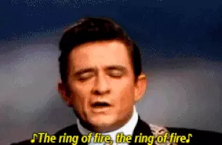
Mapping the Ring of Fire

Slide 2



DQ: Choose the correct answer and give an explanation.
Select the explanation that best explains why most earthquakes and volcanoes occur at or near plate boundaries.
As tectonic plates move away from each other, weak spots are created in the Earth’s crust. The weak spots allow for the movement of magma through the lithosphere.
Earthquakes only occur at transform boundaries as the tectonic plates slide by each other. Volcanoes are only found at convergent plate boundaries in the Ring of Fire.
At plate boundaries earthquakes occur due to friction and released tension. These locations also have increased heat and pressure which forms volcanoes.

Slide 3
Tectonic Plates and Natural Disasters
Standard 8.ESS3.2: Collect data, map, and describe patterns in the locations of locations of volcanoes and earthquakes related to tectonic plate boundaries, interactions, and hotspots. ​
Science and Engineering Practices: Using mathematics and computational thinking
Crosscutting Concepts: Patterns​

Slide 4
Earthquakes and Volcanoes
Earthquakes, Tectonic Plates, and Faultline's:
https://www.youtube.com/watch?v=t1wdrzzQOqY
Volcanoes:​
https://www.youtube.com/watch?v=WgktM2luLok

Slide 5
Mapping the Ring of Fire: TOC #14
Complete mapping the Ring of Fire in your lab groups.
Each member of your group will fill out their own paper.
Read all directions carefully.
If you need to look up locations you can use your phone or a laptop.
Turn in your completed activity to your class period box.

Slide 6
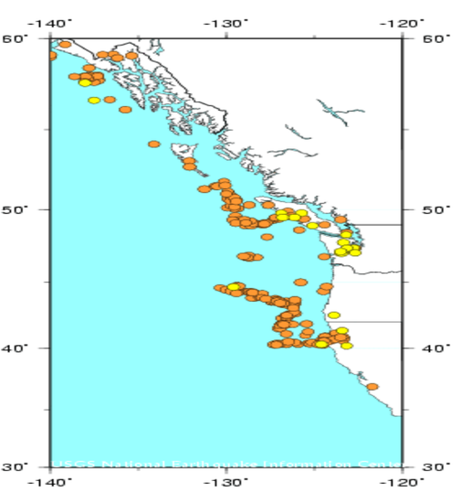
Pacific Northwest Seismic Data

Slide 7
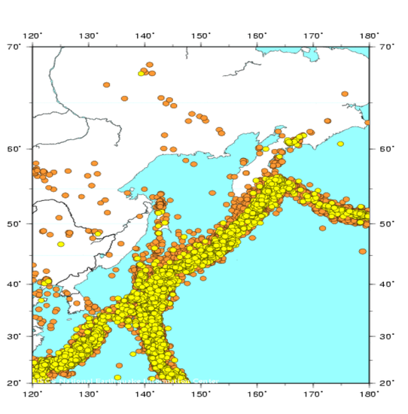
Southeast Asia Seismic Data

Slide 8
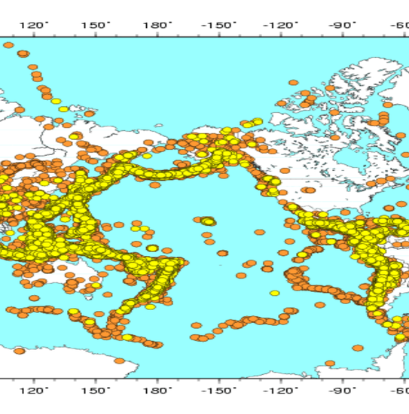
Pacific Rim Seismic Data

Slide 9
